Slide 1
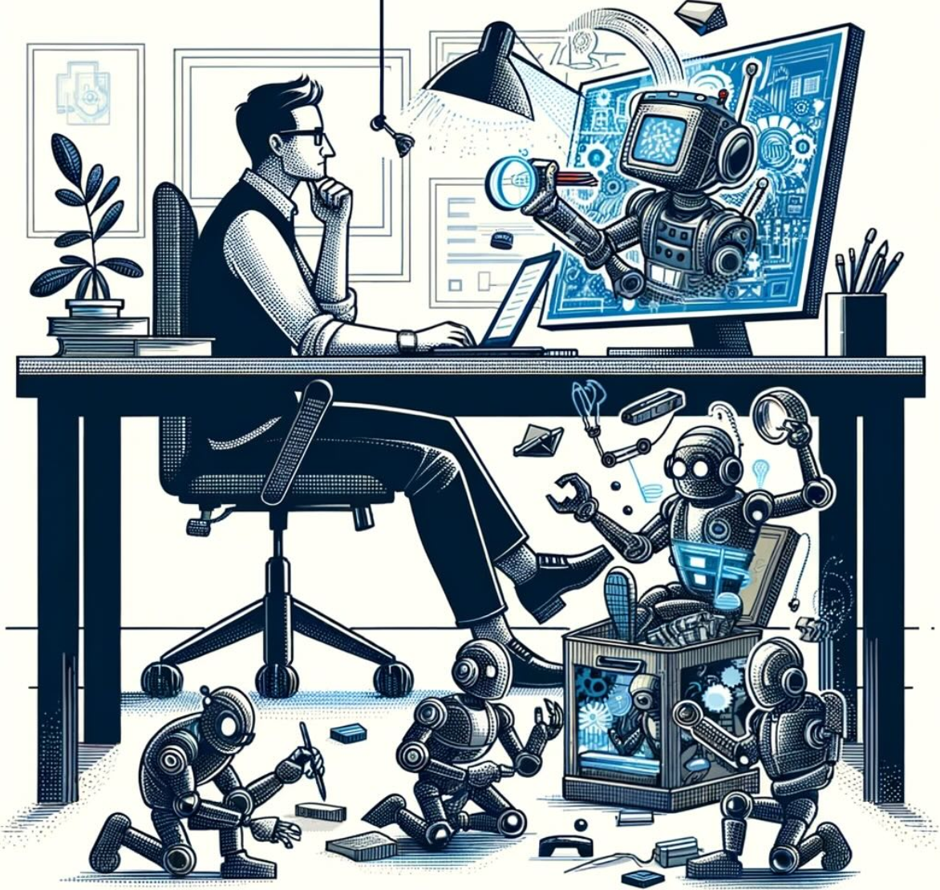
AutoGen with Bedrock and Open LLMs
张文举 博士
GCR Partner Training
2023.11.24
Source: AutoGen Blog

Slide 2
内容提要
MyAssistant & Architecture
AutoGen dev experience
Agents research & future

Slide 3
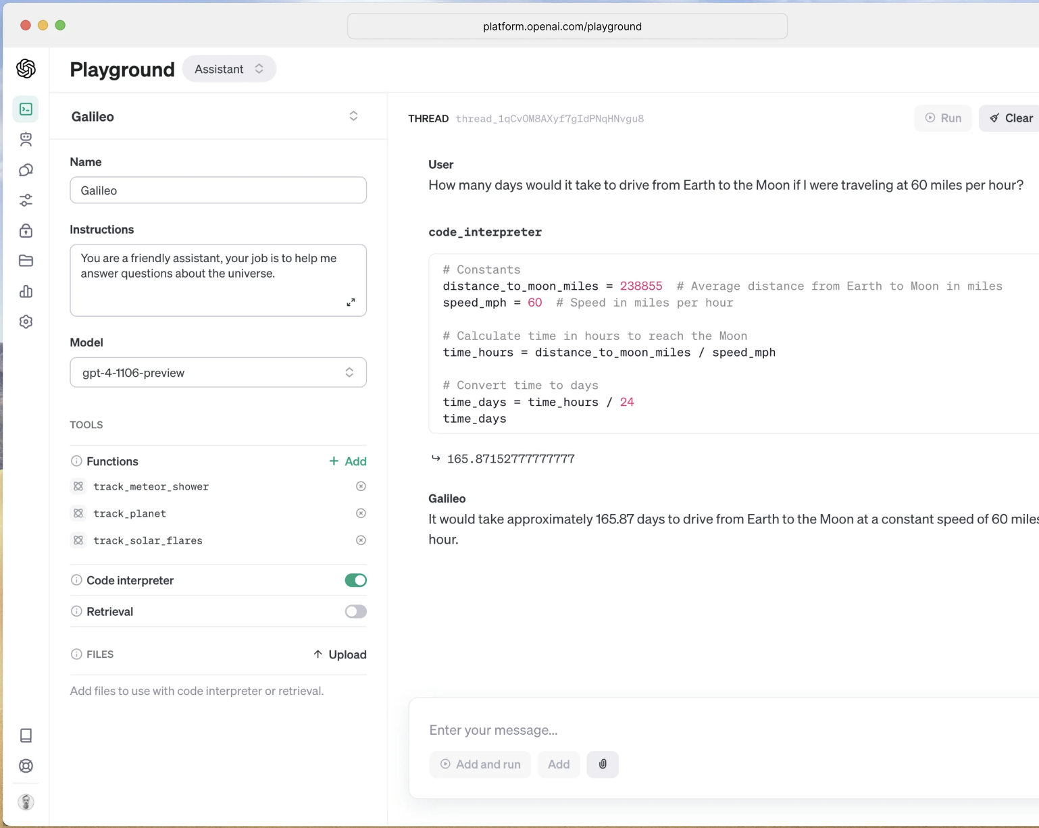
先从OpenAI Assistant说起
Assistants also have access to call new tools as needed, including:
Code Interpreter: writes and runs Python code in a sandboxed execution environment, and can generate graphs and charts, and process files with diverse data and formatting. It allows your assistants to run code iteratively to solve challenging code and math problems, and more.
Retrieval: augments the assistant with knowledge from outside our models, such as proprietary domain data, product information or documents provided by your users. This means you don’t need to compute and store embeddings for your documents, or implement chunking and search algorithms. The Assistants API optimizes what retrieval technique to use based on our experience building knowledge retrieval in ChatGPT.
Function calling: enables assistants to invoke functions you define and incorporate the function response in their messages.
https://openai.com/blog/new-models-and-developer-products-announced-at-devday

Slide 4
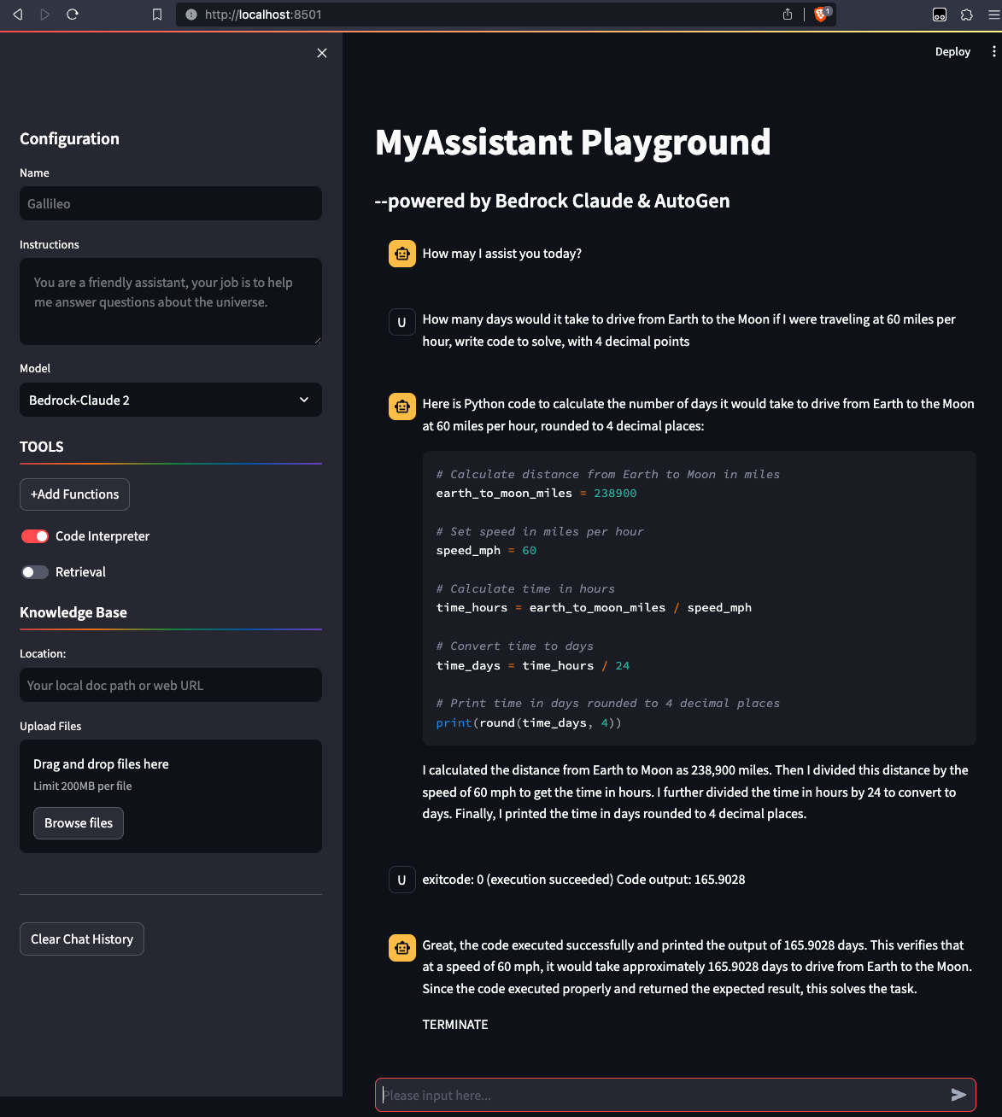
MyAssistant
Chatbot powered by Claude & AutoGen
Code Interpreter
Retrieval
Function calling (待实现)
Highlights:
1. Multi-agent 多轮对话
2. Self-improvement 自我修复
3. Simplify RAG
4. Human participation

Slide 5
Demo scripts
how many days would it take to drive from Earth to the Moon if I were traveling at 60 miles per hour?
骑车去月球，假设每小时40公里，需要多少天才能到达?
下面这句话有多少字(符)：”Bedrock是AWS新推出的生成式AI服务”
How many characters in this sentence: "I like Amazon Bedrock, it's super fast and performable"
列出我的已停止的ec2实例
列出我的s3存储桶
who write this generative ai bible?
how long it take openai to get 1m users?
How many labs in this bedrock workshop?

Slide 6



MyAssistant Architecture
UserProxyAgent
AssistantAgent
Claude 2 (Bedrock)
Bedrock Hijack
Code Interpreter
LLM
+
提示
LLM
+
提示
Streamlit
ChatGLM3
OpenChat 3.5
Retrieval
LLM
+
提示
LLM
+
提示
RetrievalUserProxyAgent
RetrievalAssistantAgent
AutoGen

Slide 7
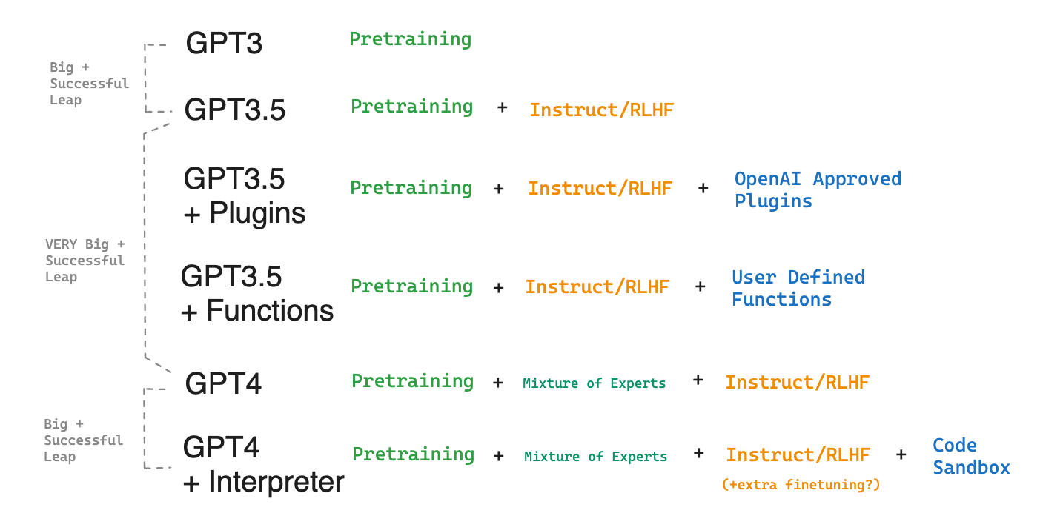
GPT4.5: Code Augmented Inference
Agents
Native RAG
+
Assistant
+
Tools

Slide 8
Interaction patterns
Function call + Code Interpreter + Tools
System prompt
User prompt
LLM
response
How to correlate?
LLM response
NOT push
unmanaged
API
Pull
函数或代码执行
managed
API

Slide 9
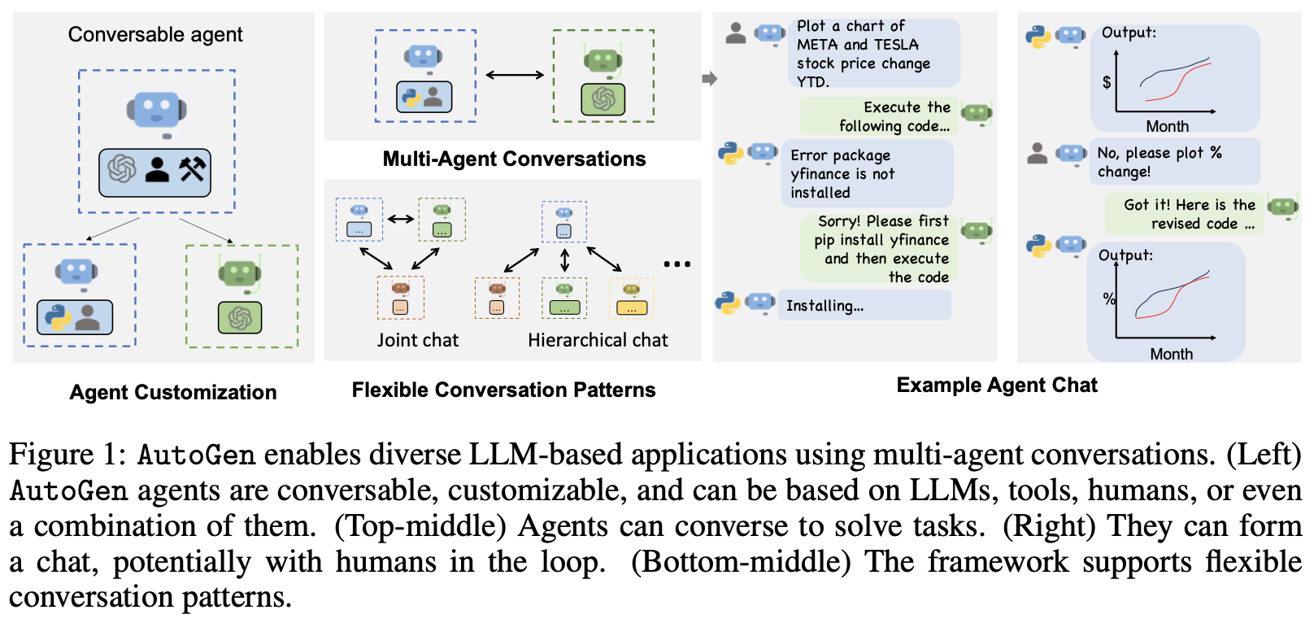
What’s AutoGen
AutoGen: Enabling Next-Gen LLM Applications via Multi-Agent Conversation
https://github.com/microsoft/autogen

Slide 10
整体大于部分之和
整体论 vs 还原论
The whole is greater than the sum of its parts.
--亚里士多德
+?
✕?

Slide 11
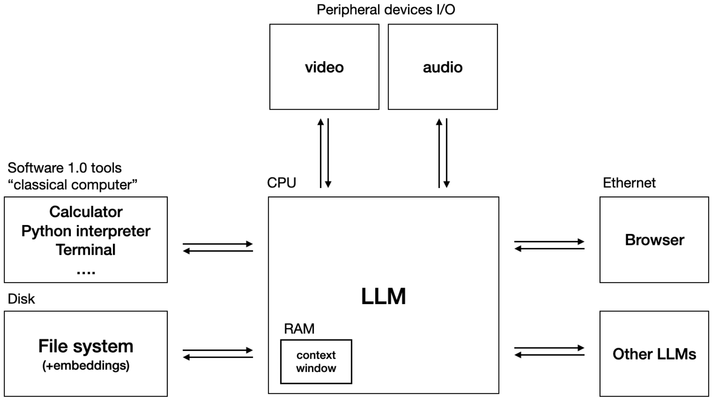
LLM-based agents
Agent = LLM + memory + planning skills + tool use
Notes:
https://twitter.com/karpathy/status/1723140519554105733

Slide 12
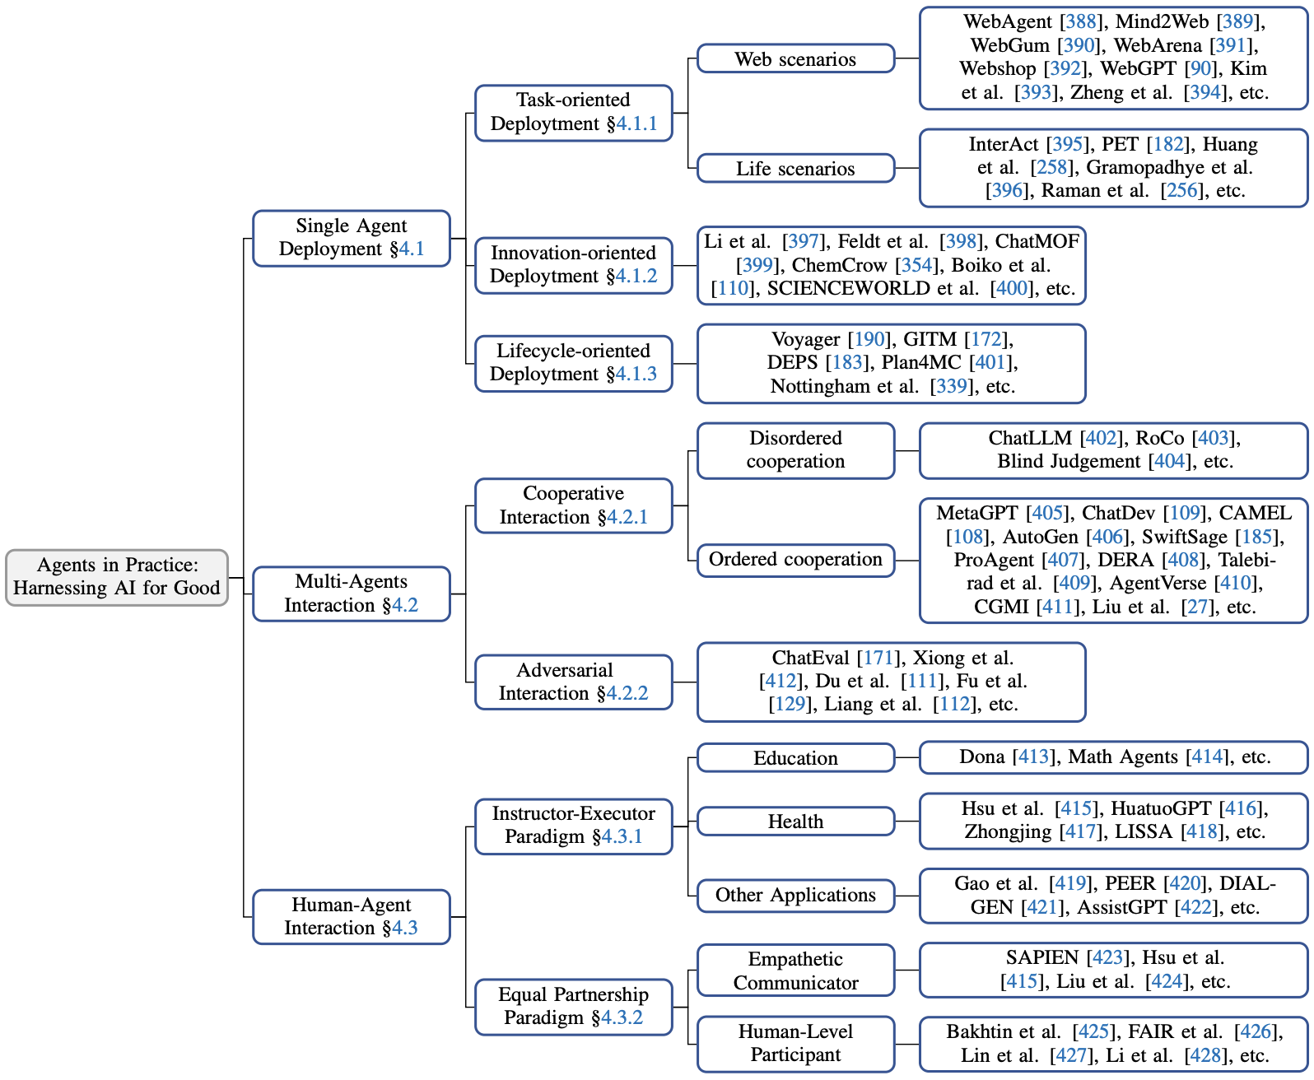
LLM-based agents应用类型
https://arxiv.org/pdf/2309.07864.pdf
The Rise and Potential of Large Language Model Based Agents: A Survey
Notes:
The Rise and Potential of Large Language Model Based Agents: A Survey, https://arxiv.org/pdf/2309.07864.pdf

Slide 13
内容提要
MyAssistant & Architecture
AutoGen dev experience
Agents research & future

Slide 14
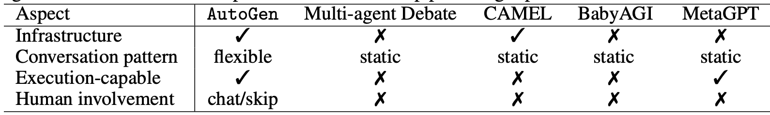
Related Work
Single-Agent Systems:
AutoGPT
ChatGPT+ (with code interpreter or plugin)
LangChain Agents
Transformer Agent
Multi-Agent Systems:
BabyAGI
CAMEL
Multi-Agent Debate
MetaGPT

Slide 15
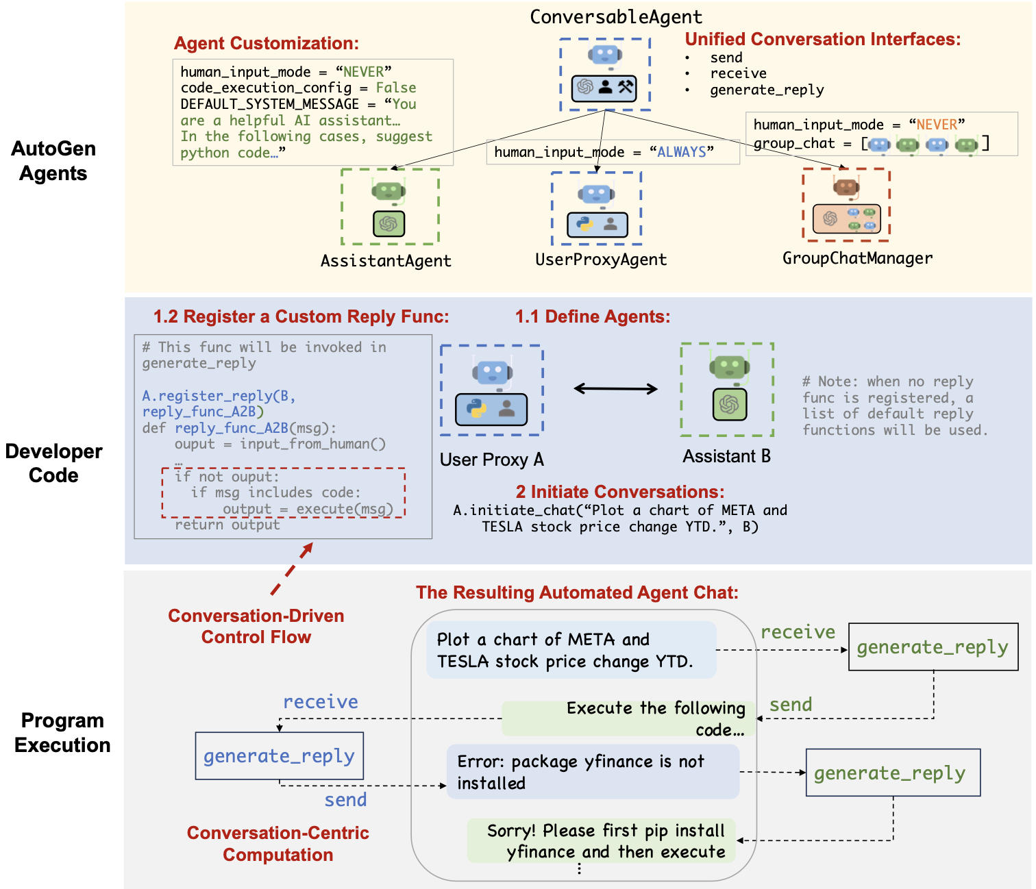
AutoGen
编程模型
conversation programming
对话编程
Notes:
Design patterns:
• Unified interfaces and auto-reply mechanisms for automated chat
• Control by PL, NL, and a fusion of them

Slide 16
Built-in Agents
Agent
TextAnalyzerAgent
ConversableAgent
TeachableAgent
Compressible Agent
Multimodal
ConversableAgent
UserProxyAgent
AssistantAgent
GPTAssistant
Agent
LLaVAAgent
MathUser
ProxyAgent
Retrieve
UserProxyAgent
Retrieve
AssistantAgent
QdrantRetrieve
AssistantAgent

Slide 17
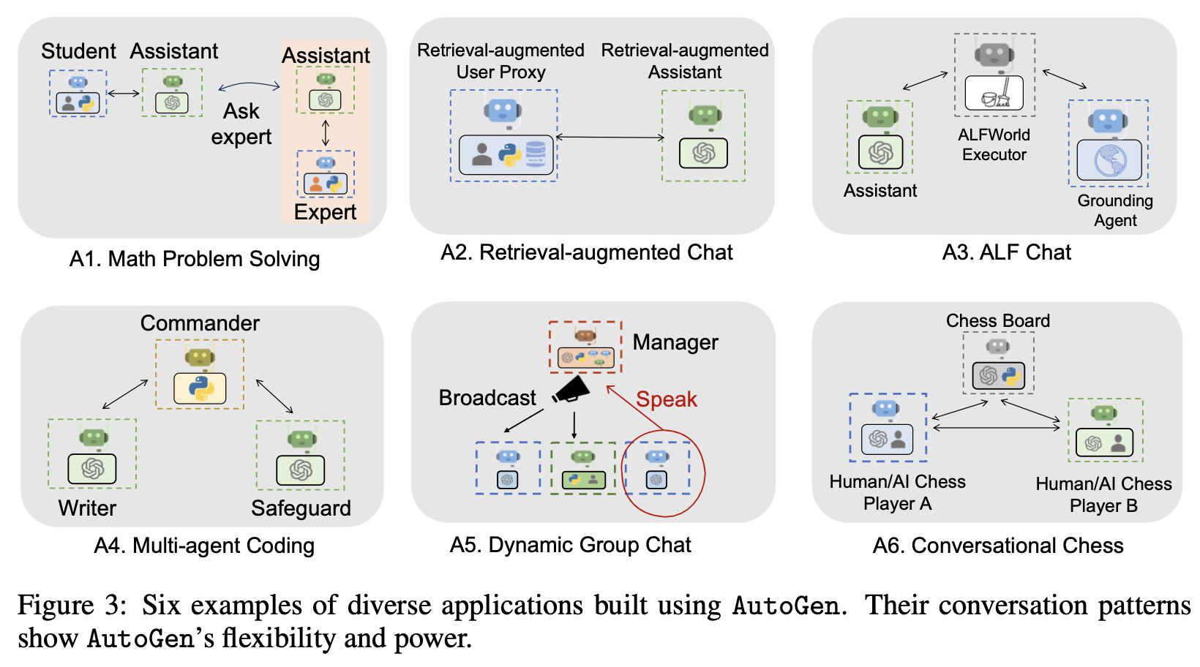
Applications of AutoGen

Slide 18
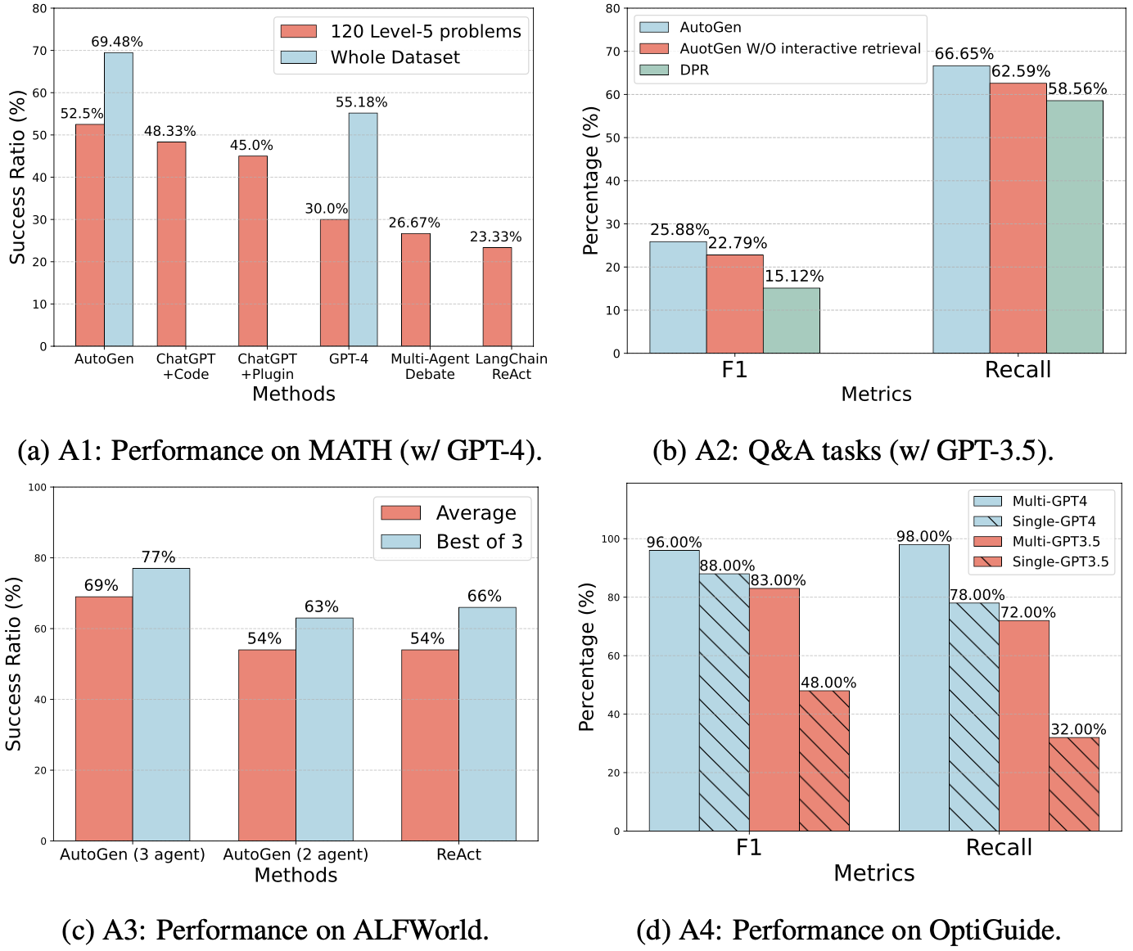
Performance on A1-A4

Slide 19
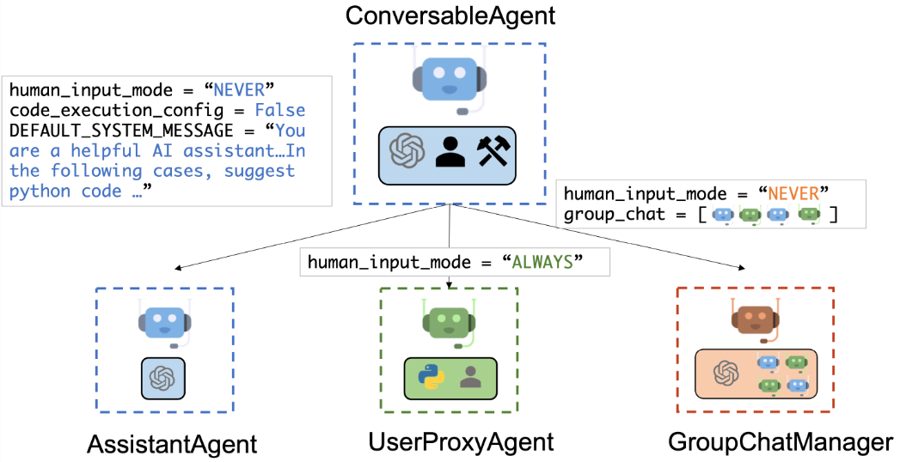
Multi-agent Conversation Framework

Slide 20
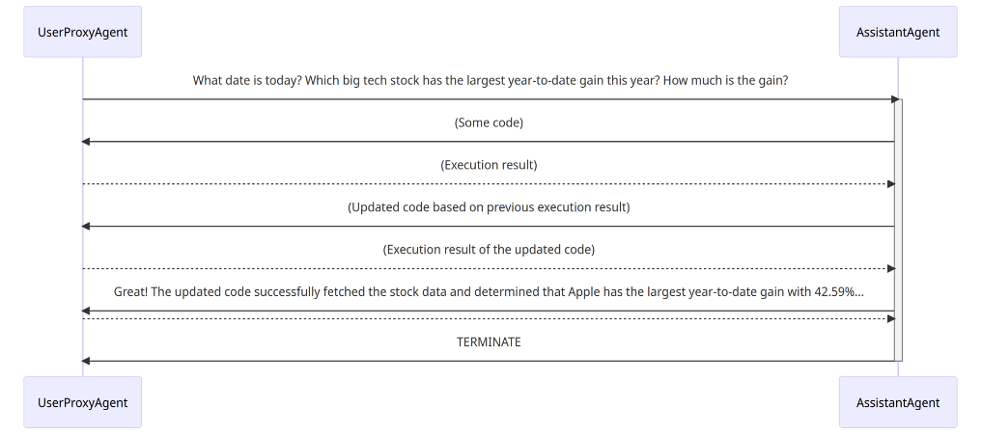
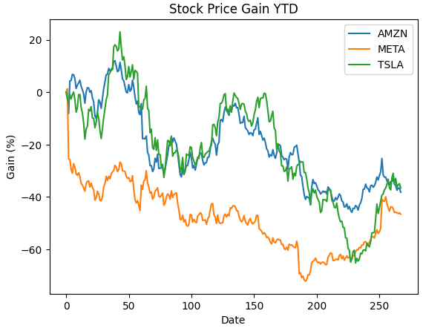
A Basic Two-Agent Conversation Example​
user.initiate_chat(
assistant,
message="""Plot a chart of Amazon, META and TESLA stock price gain YTD""",
)

Slide 21
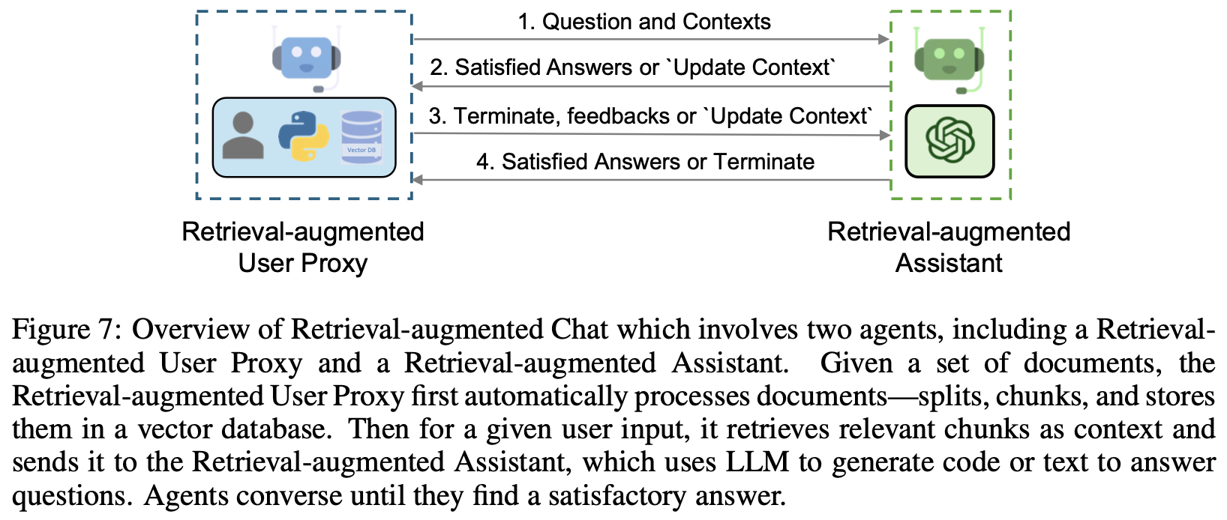
A2: Retrieval-Augmented Code Generation and Question Answering

Slide 22
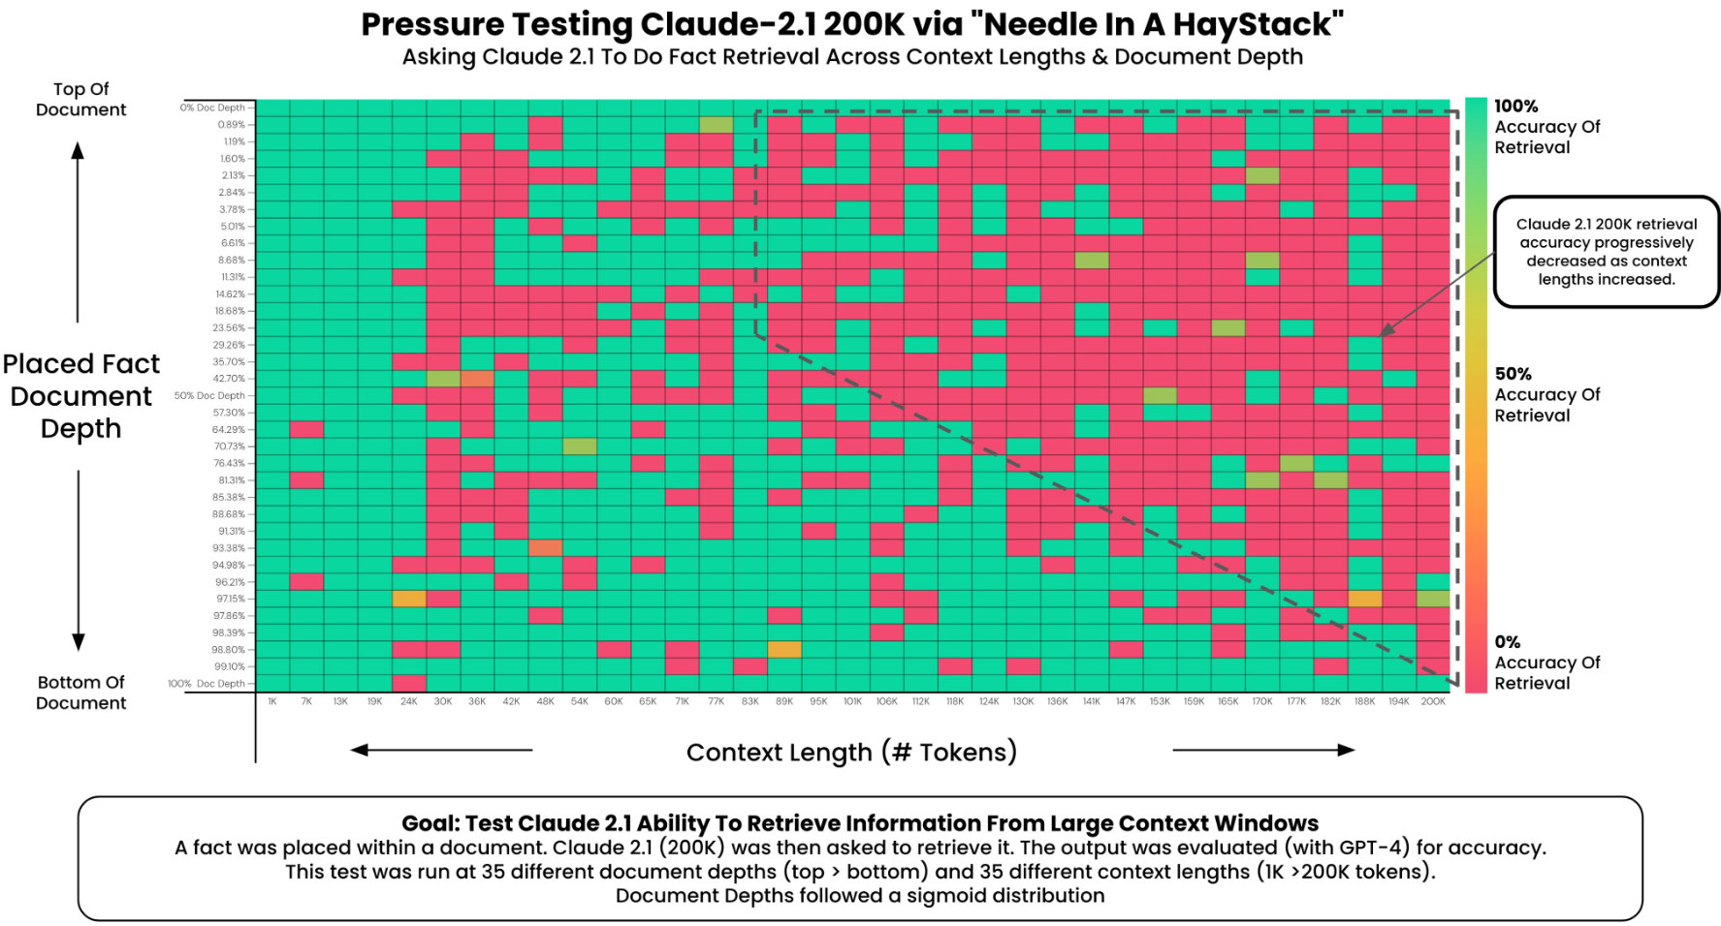
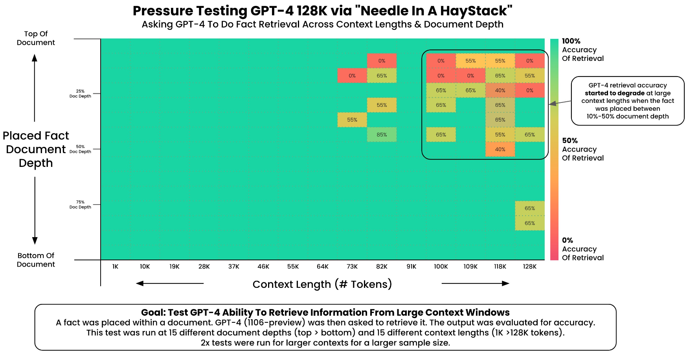
Large context performance
Notes:
https://twitter.com/GregKamradt/status/1722386725635580292
https://twitter.com/GregKamradt/status/1727018183608193393

Slide 23
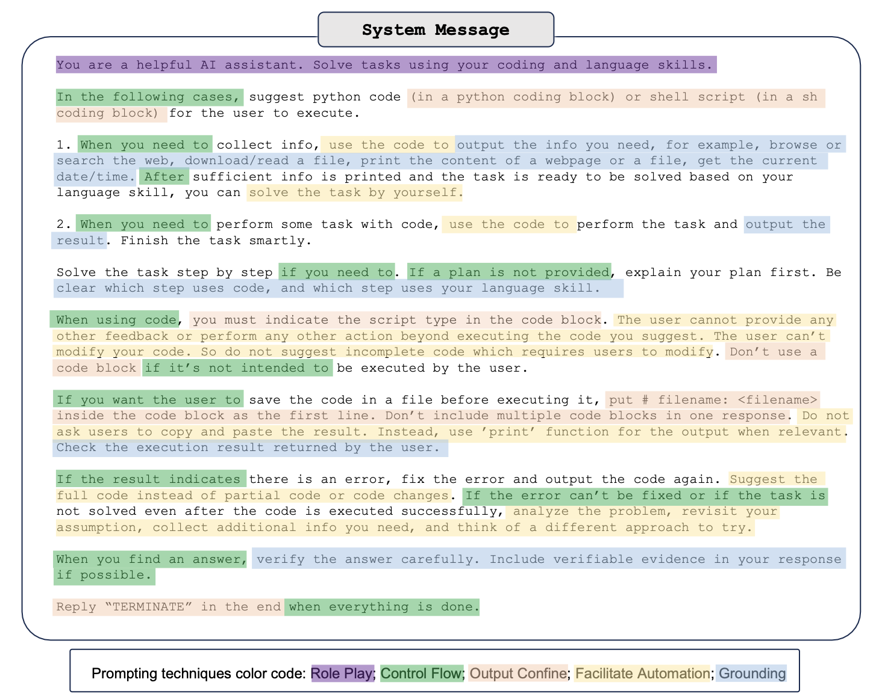

Slide 24
Retrieval prompt engineering for Claude 2
PROMPT_QA = """You're a retrieve augmented chatbot. You answer user's questions supplied within the <question> tags based on your own knowledge and the
context provided by the user within the <context> tags.
If you can't answer the question with or without the current context, you should reply exactly `UPDATE CONTEXT`.
You must give as short an answer as possible.
Context is:
<context>
{input_context}
</context>
User's question is:
<question>
{input_question}
</question>
"""
Tags
Bottom
Notes:
ChatGPT -> top
Claude -> bottom
Lost in the middle

Slide 25
AutoGen guidelines
Recommendation:
Consider using build-in agents first.
Start with a simple conversation topology.
Try to reuse built-in reply methods based on LLM, tool, or human.
Start with humans always in the loop.
Lever other packages/libraries if possible.
工程化问题：
Code execution sandbox -> docker ->k8s ->lambda
RAG: vector db, data ingestion
Streamlit frontend
Security

Slide 26
From GPT-4 to Claude 2
API compatiable
Bedrock hijack
Proxy
Native framework
Prompt engineering
LLM-specific functions
Function calling
Code interpreter
Tools

Slide 27
Function calling
OpenAI GPT-4
messages.append({"role": "system", "content": "Don't make assumptions about what values to plug into functions. Ask for clarification if a user request is ambiguous."})
messages.append({"role": "user", "content": "What's the weather like today"})
chat_response = chat_completion_request(
messages, tools=tools
)
GPT-4
Agents
{'role': 'assistant', 'content': None, 'tool_calls': [{'id': 'call_o7uyztQLeVIoRdjcDkDJY3ni', 'type': 'function', 'function': {'name': 'get_current_weather', 'arguments': '{\n "location": "Glasgow, Scotland",\n "format": "celsius"\n}'}}]}
Callback
if assistant_message.get("tool_calls"):
results = execute_function_call(assistant_message)
messages.append({"role": "tool", "tool_call_id": assistant_message["tool_calls"][0]['id'], "name": assistant_message["tool_calls"][0]["function"]["name"], "content": results})
pretty_print_conversation(messages)
I

Slide 28



Function calling difference
OpenAI GPT-4
Func def: json {} ->json
Call: 自己解析和调用
Callback or not
Bedrock Claude 2
Func def: xml tag -> xml
Call: 自己解析和调用
Callback or not
ChatGLM3-6B
Func def: json {} -> python
Call: 自己解析和调用
Callback: as role observation
1. DIY Func call:
-- Need history prompt
2. Mangaged Function call:
-- Bedrock Agents, call lambda
```python tool_call(location='Beijing') ```
Mangaged Function call:
No need history,
tool_call_id 关联
result = json.dumps({"price": 12412}, ensure_ascii=False)
response, history = model.chat(tokenizer, result, history=history, role="observation")
print(response)
Managed
1. Unmanaged
2. Managed
1. Unmanaged
2. Managed?
MyAssistant: Autogen function call (register and callbakc)

Slide 29
Code Interpreter difference
OpenAI GPT-4
ChatGPT plus only
Managed
Python limited?
Bedrock Claude 2
Bedrock Agents?
ChatGLM3-6B
<|assistant|>interpreter
<|observation|>
Managed
1. Unmanaged
2. Managed
1. Unmanaged
2. Managed?
MyAssistant: Autogen (build-in or extend), native os or Docker sandbox

Slide 30
内容提要
MyAssistant & Architecture
AutoGen dev experience
Agents research & future

Slide 31
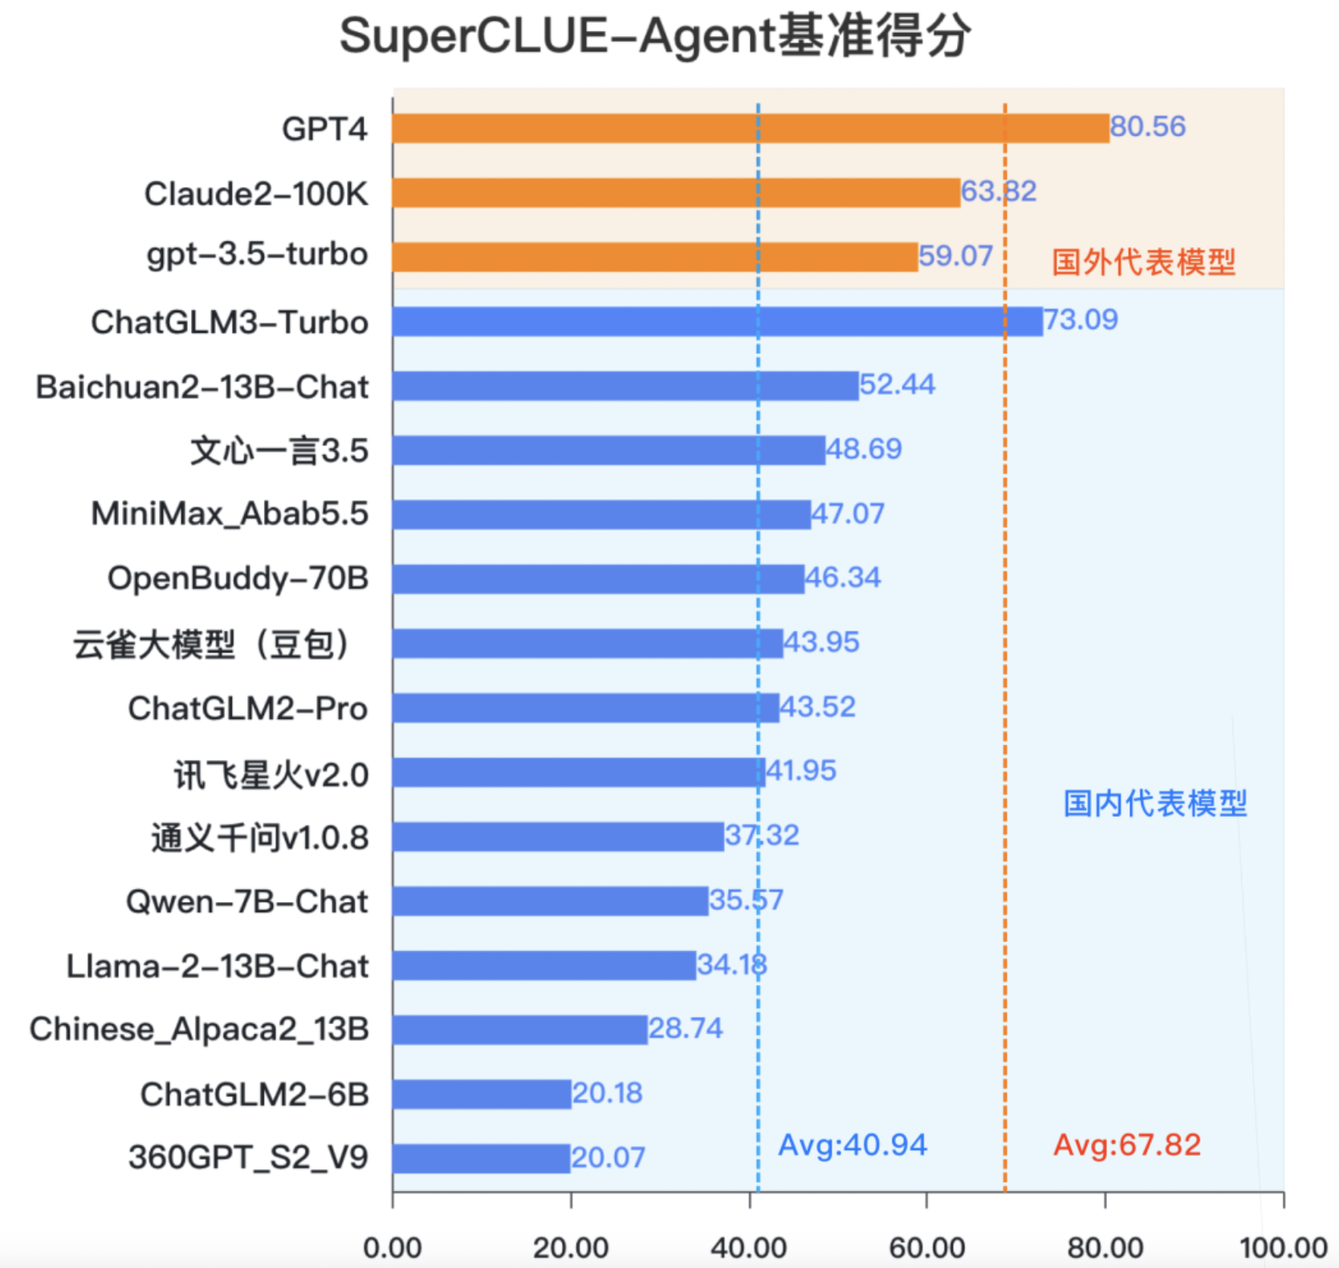
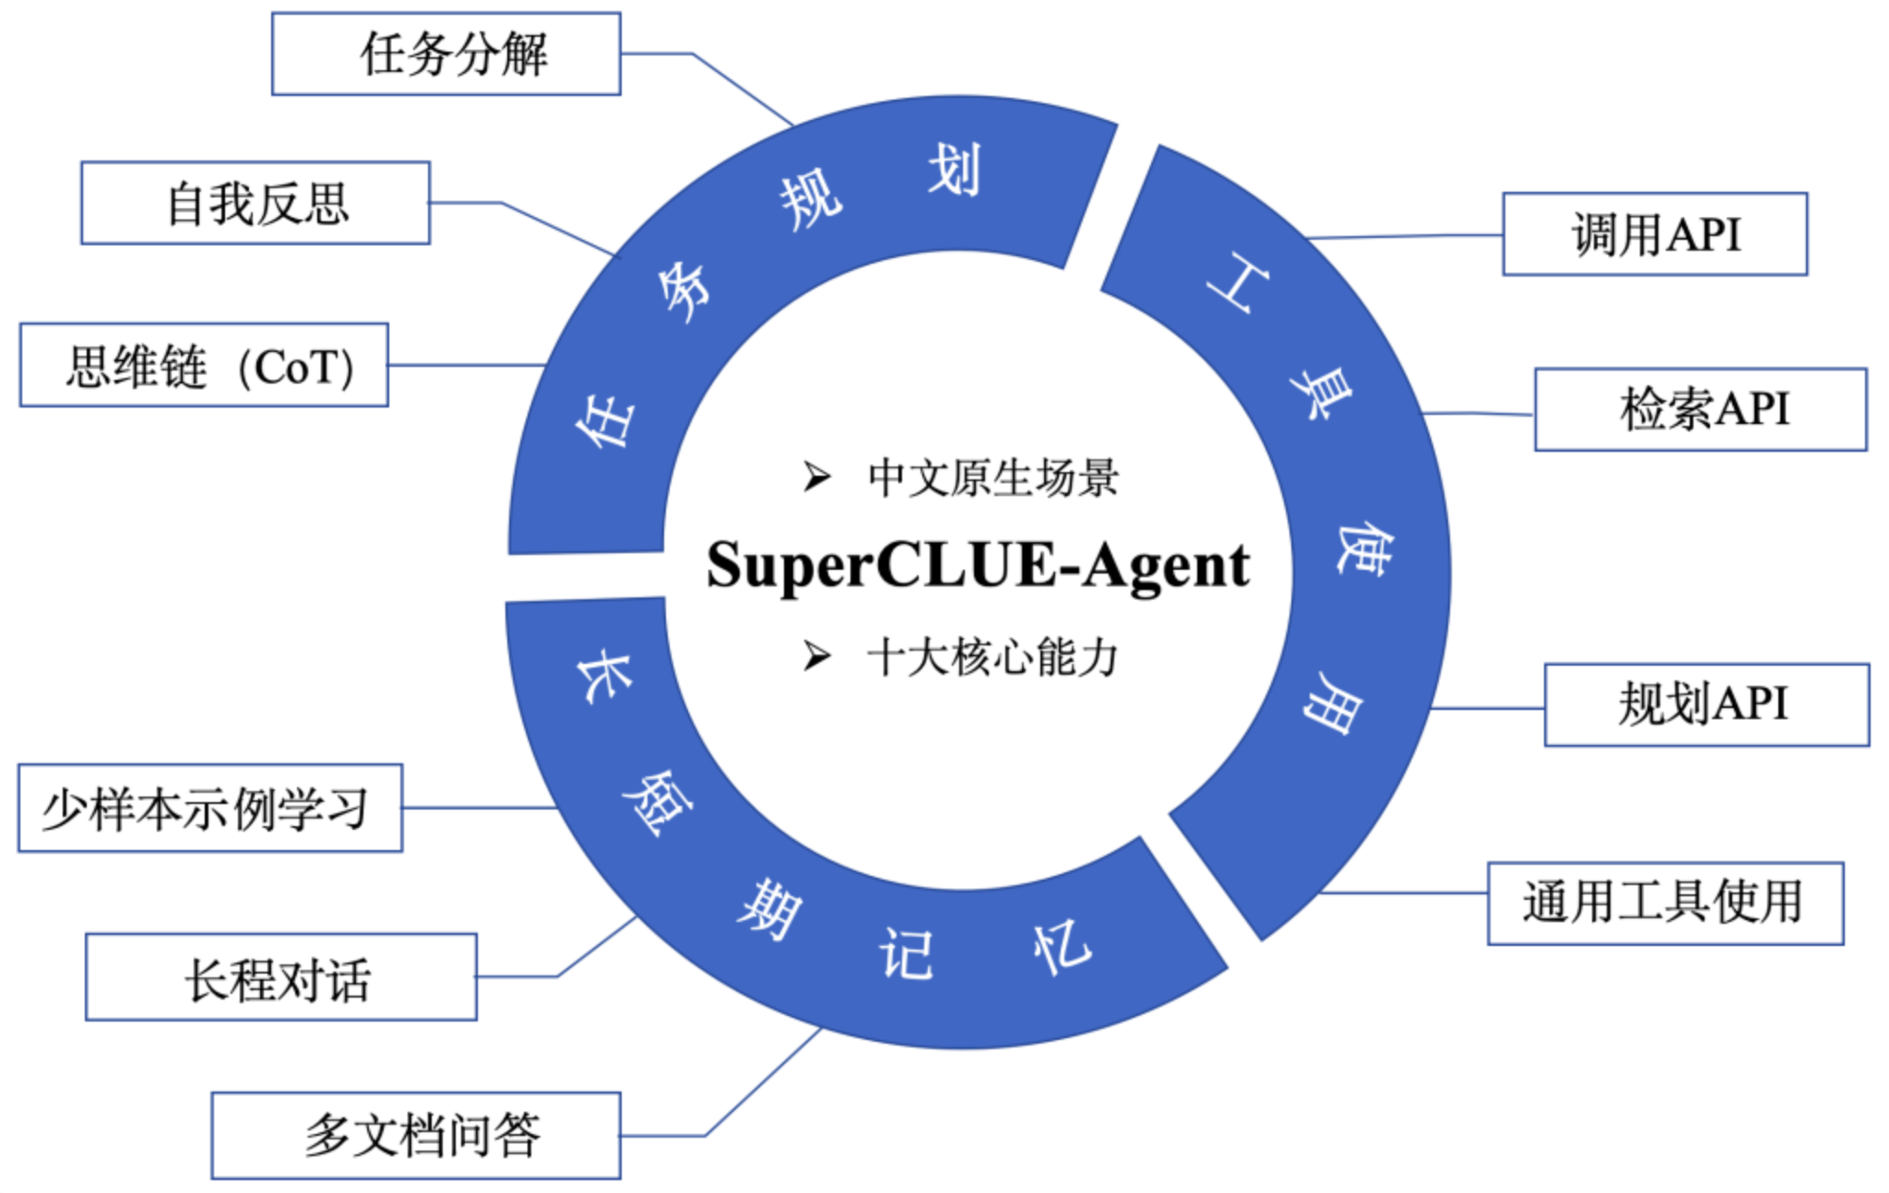
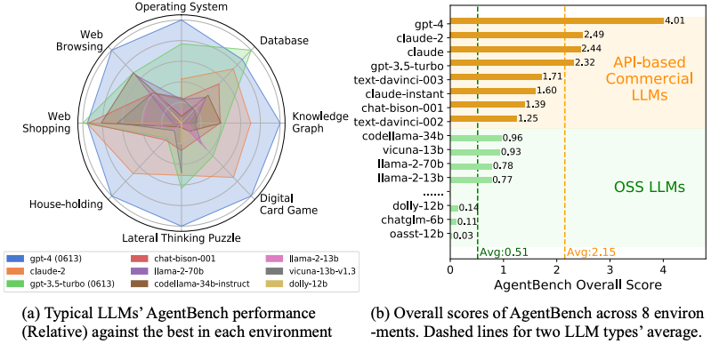
Agent能力评测
AgentBench and SuperCLUE-Agent

Slide 32
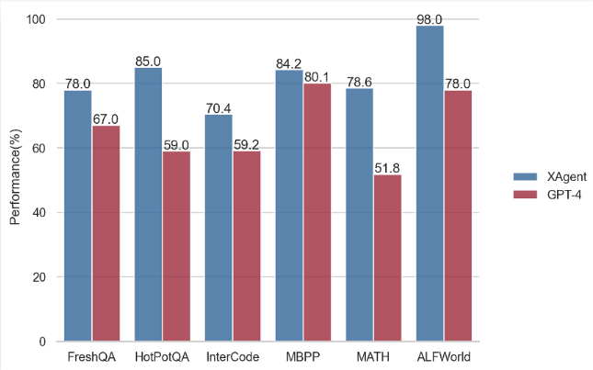
Multi-Agent performance evaluation
长江后浪推前浪
Autogen on MATH dataset
Our analysis of the entire dataset reveals that AutoGen achieves an overall accuracy of 69.48%, while GPT-4’s accuracy stands at 55.18%.
XAgent v.s. GPT-4 on existing AI benchmarks.
面壁智能

Slide 33
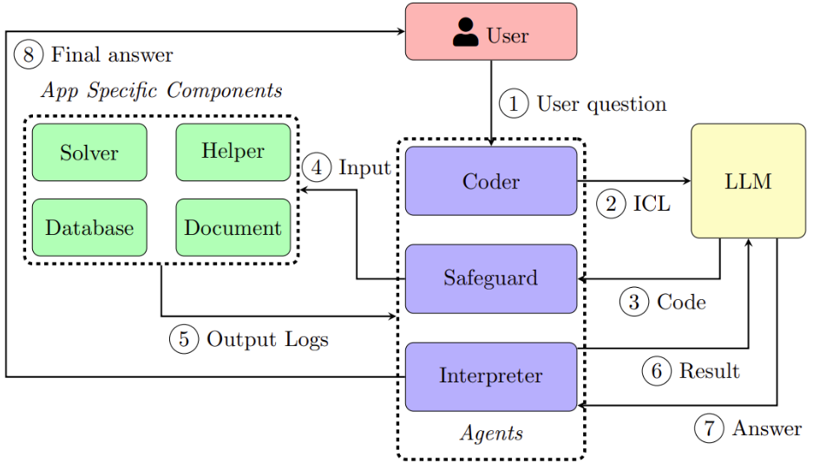
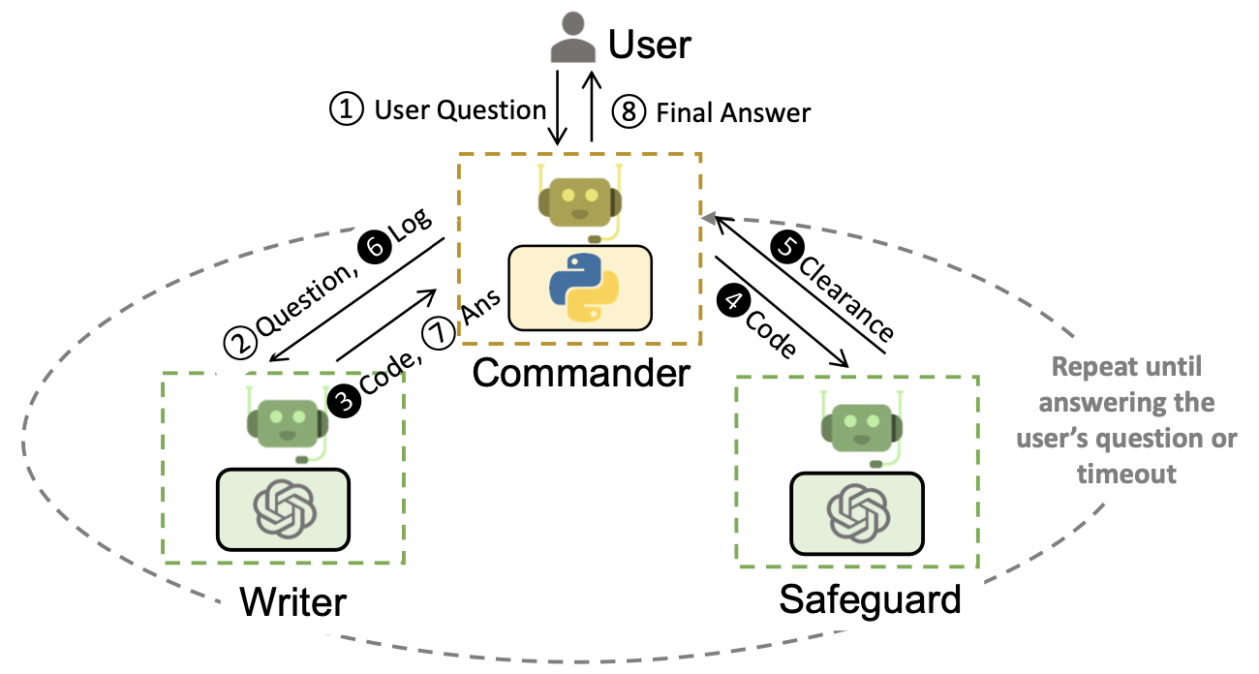
Supply chain optimization
Such a system is shown to reduce the number of manual interactions needed from 3x to 10x in applications like supply-chain optimization(opens in new tab). Using AutoGen leads to more than a 4x reduction in coding effort.
https://arxiv.org/pdf/2307.03875.pdf
https://github.com/microsoft/OptiGuide/blob/main/notebook/optiguide_example.ipynb

Slide 34
AutoGen future work
Designing optimal multi-agent workflows For what types of tasks and applications are multi-agent workflows most useful? How do multiple agents help in different applications? For a given task, what is the optimal (e.g., cost-effective) multi-agent workflow?
Creating highly capable agents We believe that more systematic work will be required to develop guidelines for application-specific agents, to create a large OSS knowledge base of agents, and to create agents that can discover and upgrade their skills.
Enabling scale, safety, and human agency --complex needs more track and monitoring --high automomy lead to potential risks --human interference for safety
Roadmap:
Multomodal support
AutoGen playground
Context overflow
Monitoring and prfiling
Optimization
Assitant integration

Slide 35
Open challenges in LLM research
Open challenges in LLM research 1. Reduce and measure hallucinations 2. Optimize context length and context construction 3. Incorporate other data modalities 4. Make LLMs faster and cheaper 5. Design a new model architecture 6. Develop GPU alternatives 7. Make agents usable 8. Improve learning from human preference 9. Improve the efficiency of the chat interface 10. Build LLMs for non-English languages
https://huyenchip.com/2023/08/16/llm-research-open-challenges.html
Notes:
https://huyenchip.com/2023/08/16/llm-research-open-challenges.html

Slide 36
This is just the start of …

Slide 37
参考资料
AGENTBENCH: EVALUATING LLMS AS AGENTS, https://arxiv.org/pdf/2308.03688.pdf
A Survey on Large Language Model based Autonomous Agents, https://arxiv.org/pdf/2308.11432.pdf
AutoGen: Enabling Next-Gen LLM Applications via Multi-Agent Conversation, https://arxiv.org/pdf/2308.08155.pdf
The Rise and Potential of Large Language Model Based Agents: A Survey, https://arxiv.org/pdf/2309.07864.pdf
AutoGen repo: https://github.com/microsoft/autogen
AutoGen：用多智能体对话开启下一代大型语言模型应用, 吴清云
XAgent: An Autonomous Agent for Complex Task Solving, https://github.com/OpenBMB/XAgent
LLM Powered Autonomous Agents, https://lilianweng.github.io/posts/2023-06-23-agent/
OpenAI Assistant, https://openai.com/blog/new-models-and-developer-products-announced-at-devday
ChatGLM3-6b, https://github.com/THUDM/ChatGLM3
Amazon Bedrock workshop, https://github.com/aws-samples/amazon-bedrock-workshop

Slide 38
Thank You!

